Slide 1
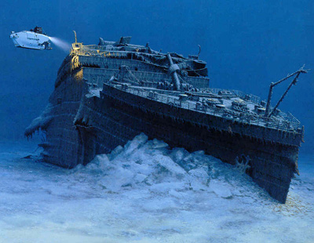
The TITANIC

Slide 2
The titanic was once the boat of everybody’s dream, the dream of a lifetime. How could it be that this wonder of technology sank on its very first voyage. Let’s dive into the waters of history to learn about it better.

Slide 3
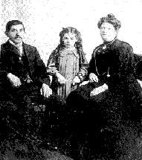
The people
How many people survived the wreckage?
Who was the youngest survivor? And How old?
Who was the “unsinkable” Molly Brown?
http://www.history.com/topics/titanic/photos#the-titanic-passengers-and-possessions
http://www.history.com/
topics/titanic

Slide 4
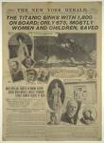
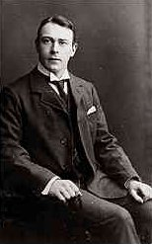
The people
Who were John Chatterton and Richie Kohler?
Who was Thomas Andrews?
What can you tell about Eva Hart?
http://www.history.com/topics/titanic/videos#titanic-what-happened-after---first-class-passengers
http://www.euronet.nl/users/keesree/start.htm

Slide 5
The numbers
What are the numbers of the Titanic?
How much did it weigh? What was its size? How many decks there were? How long was it? How fast could it sail? How long did it take to build it?
How many passengers were on the ship? How many members in the crew?
How much food was required for provisions on board?
What percentage was there about lifeboats capacity? What was the rate of survivors who could finally return?

Slide 6
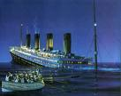
The numbers
http://www.history.com/topics/titanic/videos#titanic-deconstructed
http://www.keyflux.com/titanic/facts.htm

Slide 7
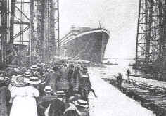
The ship

Slide 8
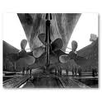
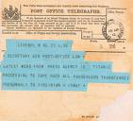
The ship
Explain how the most legendary ship of all times was built. propellers, bow, top deck, promenade deck, the bridge, telegraphs,
http://www.history.com/topics/titanic/photos#the-titanic-before-and-after

Slide 9
The iceberg
Lookouts at the mast, crew at the bridge, captain paying attention, then the mist..... The night..... They could see what was in front of them just a few second before the crash was produced. Could this disaster have been prevented and so many lives been saved?

Slide 10
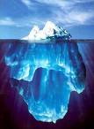
The iceberg
How long before could the crew have avoided the disaster?
What instrument were the lookouts not using when they were at the top of the mast?
http://www.history.com/topics/titanic/videos#titanics-achilles-heel-attempt-to-avoid-disaster

Slide 11
The final resting place

Slide 12
The final resting place
Where is this wonderful ship resting? Can you give the exact location
http://maps.google.es/maps?hl=es&rls=ig&gbv=2&q=the%20titanic%20bridge&ie=UTF-8&sa=N&tab=il

Slide 13
assessment

Slide 14
conclusions

