Slide 1

Simple Past vs. Past Continuous
When do we use
each tense?
By Pam0007

Slide 2

Use the simple past for:
1) action that happened in the past and is . . .
over, done, finished
Use the past continuous for:
action that was in progress at a specific point in the past OR
2) focusing on an action that continued for a long time in the past
Examples . . .

Slide 3

Simple Past (Examples)
Action that was completed in the past:
Tom went fishing last week.
I worked until 2:00 p.m. yesterday.
My family came to visit me last year.
*Time Expressions frequently used with the simple past:
yesterday, last ______,
past dates (in 1990), _____ ago, etc.

Slide 4

Past Continuous (Examples)
Action that was in progress at a particular point in the past:
At 2:00 yesterday, Tom was playing soccer.
Sophia wasn’t home last night when I called her. I think she was working.
Lisa and her husband were visiting us last week.

Slide 5

Grammar Structure:
Here are some reminders about how to make the simple past and past continuous:

Slide 6

The Past Continuous:
Don’t forget that VERB BE is part of this structure.
I, He, She, It WAS
You, We, They WERE
verb
-ING
+

Slide 7

Examples:
My mom was trying to call me last night, but I wasn’t home.
The kids were studying last night at 9:00.
I was cleaning my house all day yesterday.

Slide 8

Past Continuous (Negative)
For this tense, simply ADD the word NOT after the verb BE.
They were arguing last night.
They were NOT arguing last night.
She was yelling at me.
She was NOT yelling at me.

Slide 9

Important Note about
Past Continuous!
Some verbs are NOT typically used in the continuous tense. Instead, we prefer to use these verbs in the simple tenses (simple present or past).
These verbs are called STATIVE (or non-action) verbs. Here are some examples:
want like love hate
know need see hear
believe understand have (possession)
Forget remember belong

Slide 10

Examples:
I liked Rome.
NOT: I was liking Rome.
She had a headache.
NOT: She was having a headache.
I knew the answer.
NOT: I was knowing the answer.
_____________
_____________
_____________

Slide 11
Past Progressive & Simple Past 1
Use past progressive with simple past to describe an action that was interrupted by another action.
They were enjoying the morning when the thief stole the briefcase.
They were enjoying the morning when the thief stole the briefcase.
stole
now
future
past
were enjoying

Slide 12
Past Progressive & Simple Past 2
Use past progressive for the action in progress. Use when and the simple past for the action that interrupts.
The man was reading the newspaper when the thief snatched his briefcase.
The man was reading the newspaper when the thief snatched his briefcase.
snatched
now
past
future
was reading

Slide 13
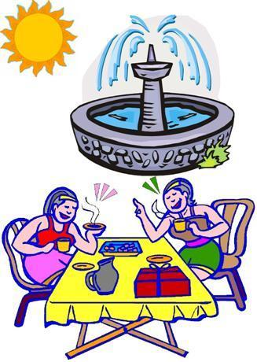
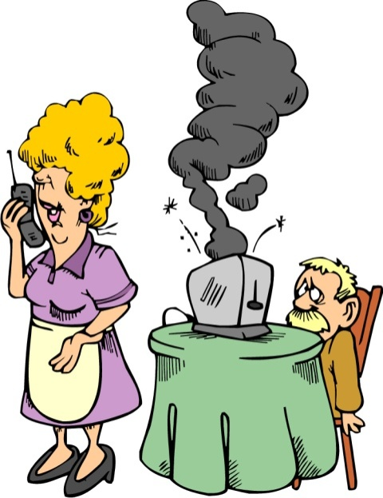
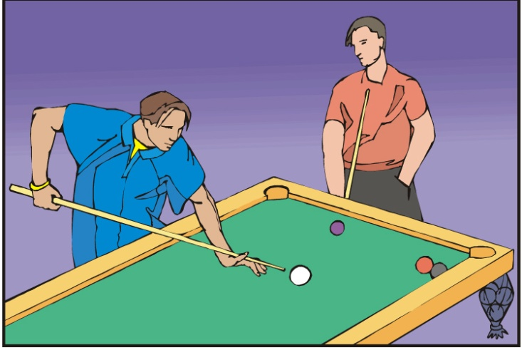
Practice 2
Form sentences with while. Use the past progressive.
Example: read / steal
While the man was reading, the prisoner was stealing his wallet.
1. talk / drink
3. play / watch
4. not look / burn
2. shine / splash
5. talk / sit
4. While the woman was not looking, the toast was burning.
5. While the woman was talking on the phone, the man was sitting in the chair.
3. While one man was playing pool, the other man was watching.
1. While the women were talking, they were drinking tea.
2. While the sun was shining, the fountain was splashing.

Slide 14

PAST SIMPLE | PAST CONTINUOUS
PARA HABLAR DE UNA ACCIÓN ACABADA EN UN TIEMPO ANTES DE AHORA EN UN MOMENTO DETERMINADO. John Cabot sailed to America in 1498. EXPRESIONES DE PASADO SIMPLE: frecuencia: often, sometimes, always; un punto determinado en el tiempo: last week, when I was a child, yesterday, six weeks ago. un punto no determinado en el tiempo: the other day, ages ago, a long time ago etc. Ejemplos: Yesterday, I arrived in Geneva. She always played the piano when she was a child. | EXPRESA UNA ACCIÓN LARGA O INCOMPLETA EN EL PASADO: "I was going to spend the day at the beach but I've decided to go on an excursion instead.” PARA DESCRIBIR UNA ACCIÓN LARGA INTERRUMPIDA POR OTRA CORTA: “I was having a beautiful dream when the alarm clock rang.“ PARA DESCRIBIR EL CONTEXTO EN QUE SE DESARROLLA UNA ACCIÓN: “It was getting dark. The prince was walking silently around the hall...”

Slide 15

Exercise 1
Exercise 2
In the www section

